Slide 1

Introducing Python. Pycharm IDE.
Fredrick Michael Ogore||0717105568||

Slide 2
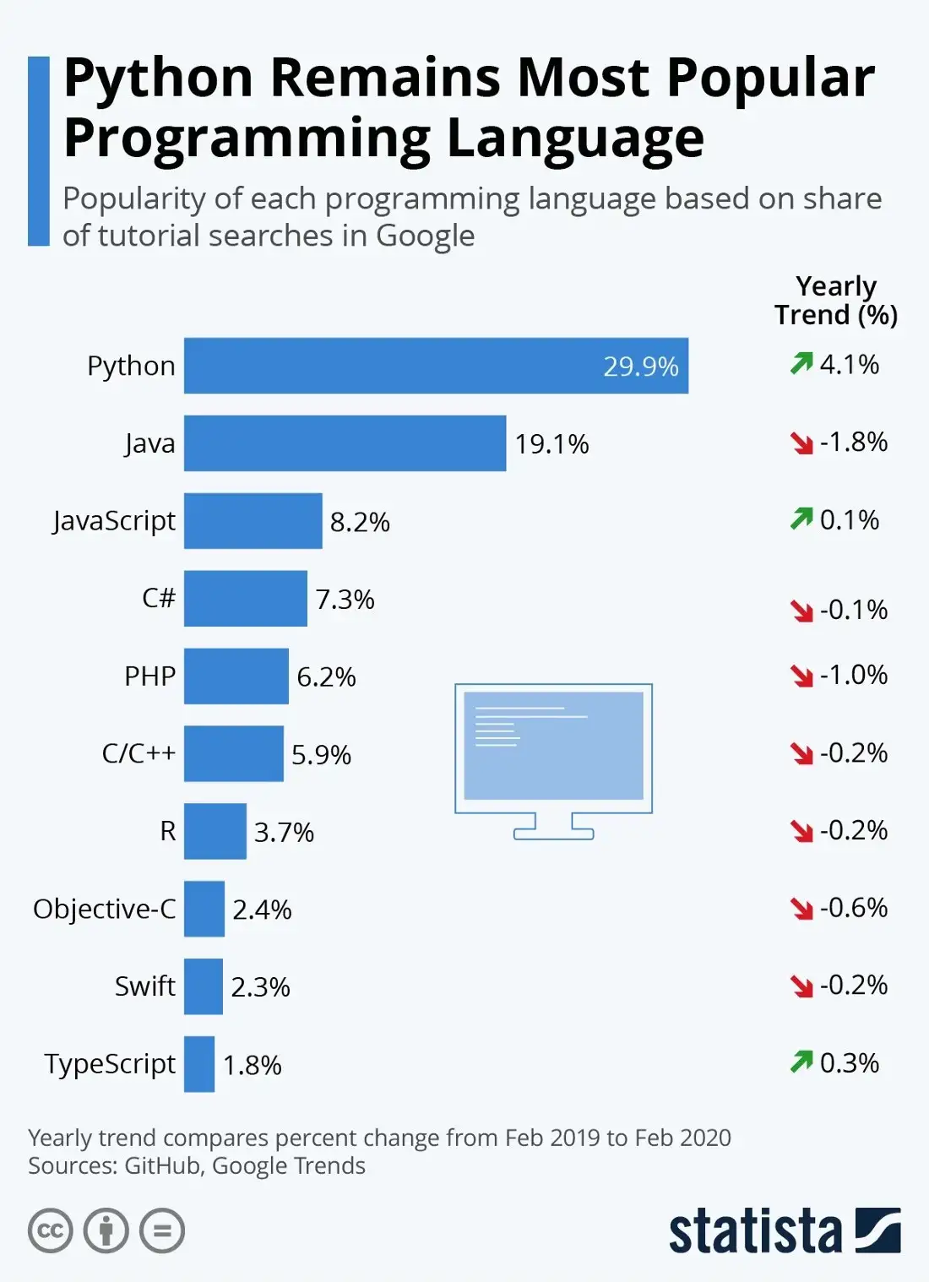

Slide 3
Python AI.
Install pycharm IDE
Created a project.
Created a file in the project.
Created the source code.
Ran this source code.

Slide 4
Python AI.
PyCharm is the most popular IDE for Python, and includes great features such as excellent code completion and inspection with advanced debugger and support for web programming and various frameworks.
PyCharm is created by Czech company, Jet brains which focusses on creating integrated development environment for various web development languages like JavaScript and PHP.

Slide 5
Python AI.
PyCharm is the most popular IDE used for Python scripting language. This chapter will give you an introduction to PyCharm and explains its features.
PyCharm offers some of the best features to its users and developers in the following aspects −
Code completion and inspection
Advanced debugging
Support for web programming and frameworks such as Django and Flask

Slide 6
Features of PyCharm
Besides, a developer will find PyCharm comfortable to work with because of the features mentioned below −
Code Completion
PyCharm enables smoother code completion whether it is for built in or for an external package.
SQLAlchemy as Debugger
You can set a breakpoint, pause in the debugger and can see the SQL representation of the user expression for SQL Language code.
Git Visualization in Editor
When coding in Python, queries are normal for a developer. You can check the last commit easily in PyCharm as it has the blue sections that can define the difference between the last commit and the current one.
Code Coverage in Editor
You can run .py files outside PyCharm Editor as well marking it as code coverage details elsewhere in the project tree, in the summary section etc.

Slide 7
Features of PyCharm
Package Management
All the installed packages are displayed with proper visual representation. This includes list of installed packages and the ability to search and add new packages.
Local History
Local History is always keeping track of the changes in a way that complements like Git. Local history in PyCharm gives complete details of what is needed to rollback and what is to be added.
Refactoring
Refactoring is the process of renaming one or more files at a time and PyCharm includes various shortcuts for a smooth refactoring process.
User Interface of PyCharm Editor
The user interface of PyCharm editor is shown in the screenshot given below. Observe that the editor includes various features to create a new project or import from an existing project.

Slide 8
PyCharm Download
https://www.jetbrains.com/pycharm/

Slide 9
PyCharm Basics
When you launch PyCharm for the first time, you can see a welcome screen with entry points to IDE such as −
Creating or opening the project
Checking out the project from version control
Viewing the documentation
Configuring the IDE

Slide 10
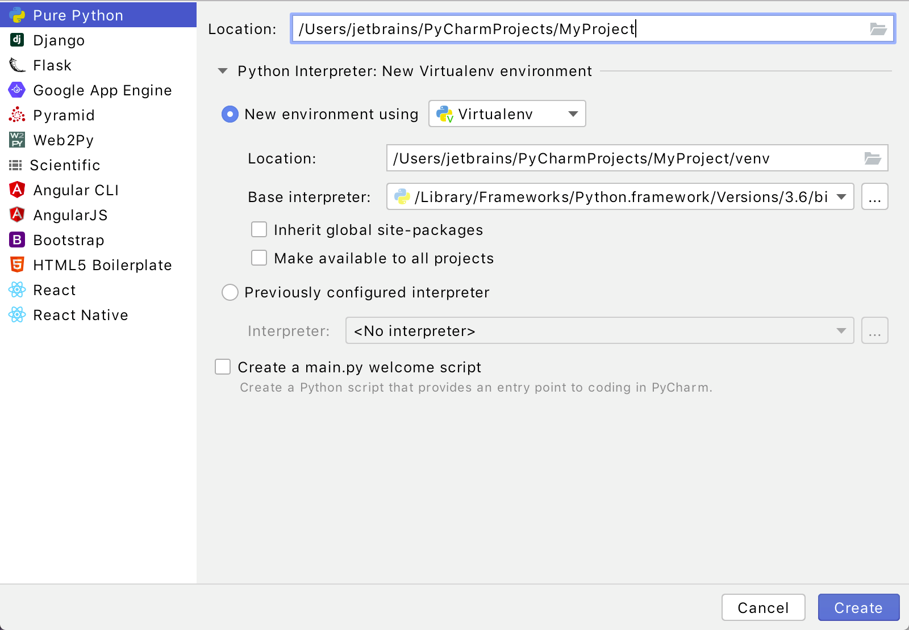
Step 1. Create and run your first Python project

Slide 11
Python AI.
If you’re on the Welcome screen, click New Project. If you’ve already got any project open, choose File | New Project from the main menu.
Although you can create projects of various types in PyCharm, in this tutorial let's create a simple Pure Python project. This template will create an empty project.

Slide 12
Python AI.
Choose the project location. Click the Browse button button next to the Location field and specify the directory for your project.
Also, deselect the Create a main.py welcome script checkbox because you will create a new Python file for this tutorial.
Python best practice is to create a virtualenv for each project. In most cases, PyCharm create a new virtual environment automatically and you don't need to configure anything. Still, you can preview and modify the venv options. Expand the Python Interpreter: New Virtualenv Environment node and select a tool used to create a new virtual environment. Let's choose Virtualenv tool, and specify the location of the environment and the base Python interpreter used for the new virtual environment.

Slide 13
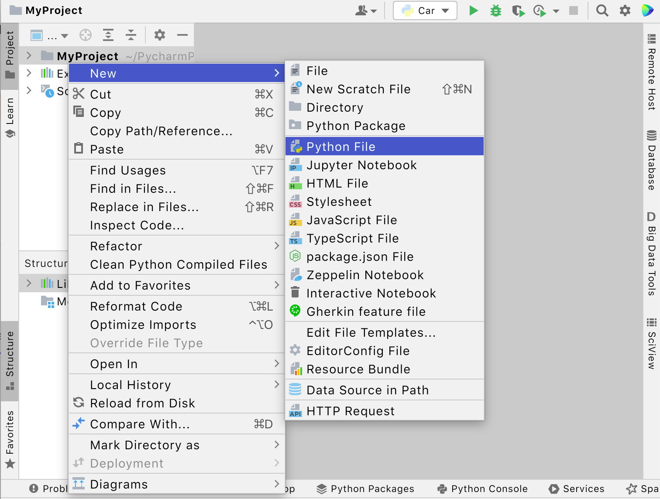
Create a Python file﻿.
STEP-1:In the Project tool window, select the project root (typically, it is the root node in the project tree), right-click it, and select File | New ....

Slide 14
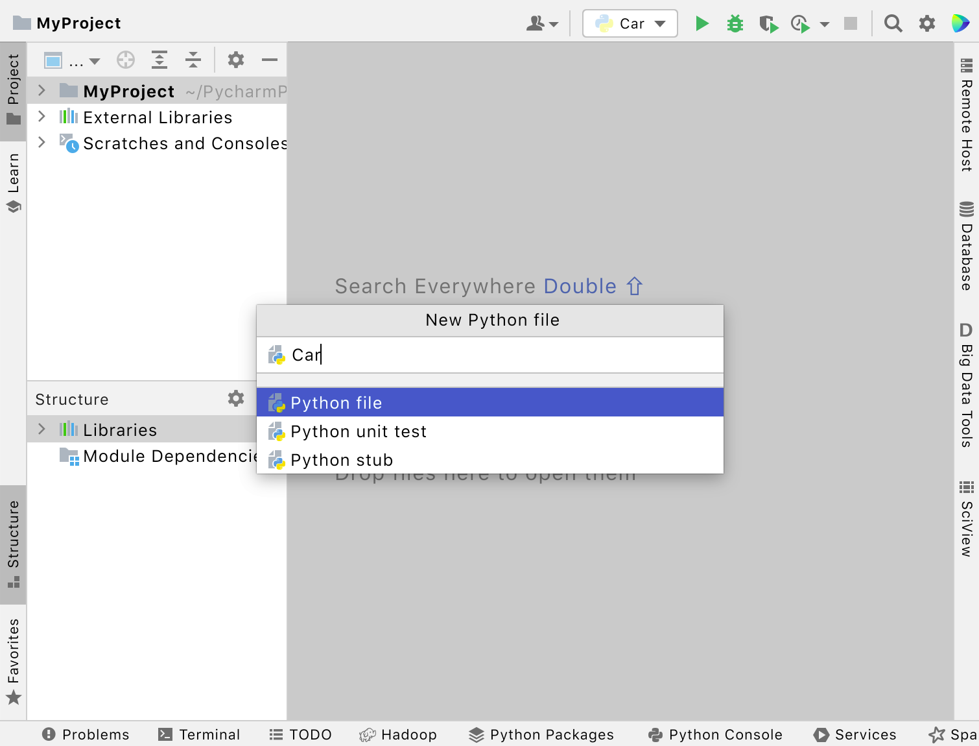
Create a Python file﻿.
STEP 2:
Select the option Python File from the context menu, and then type the new filename.

Slide 15
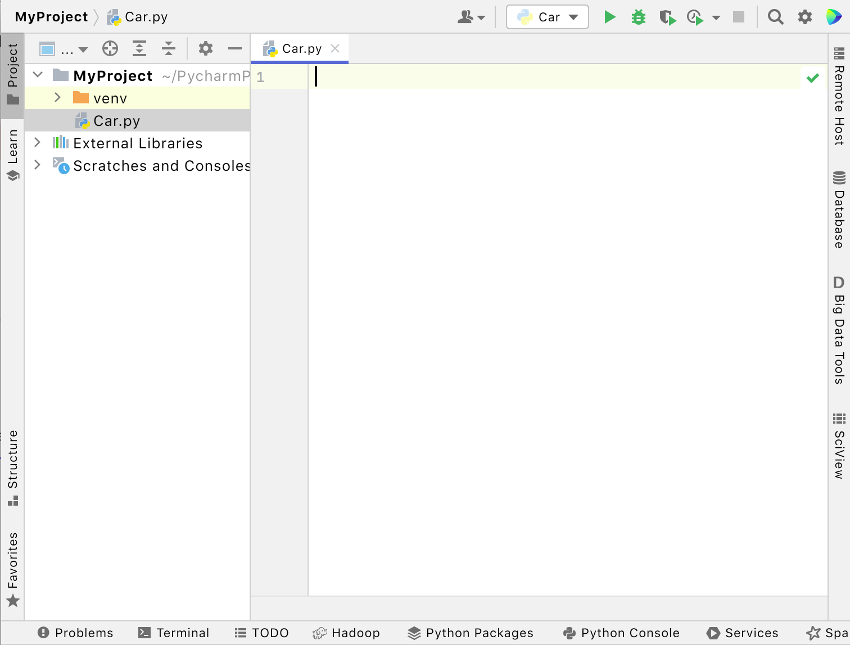
Create a Python file﻿.
STEP 3:
PyCharm creates a new Python file and opens it for editing.

Slide 16
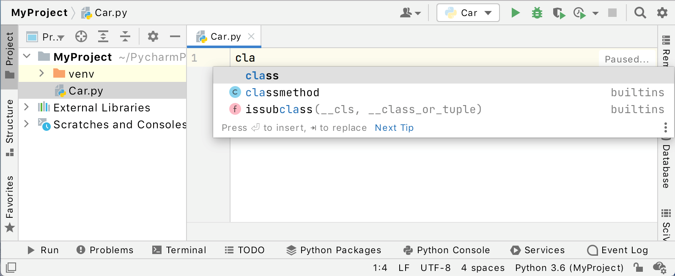
Edit Python code﻿
Let's start editing the Python file you've just created.
STEP 1:Start with declaring a class. Immediately as you start typing, PyCharm suggests how to complete your line:
Choose the keyword class and type the class name, Car

Slide 17
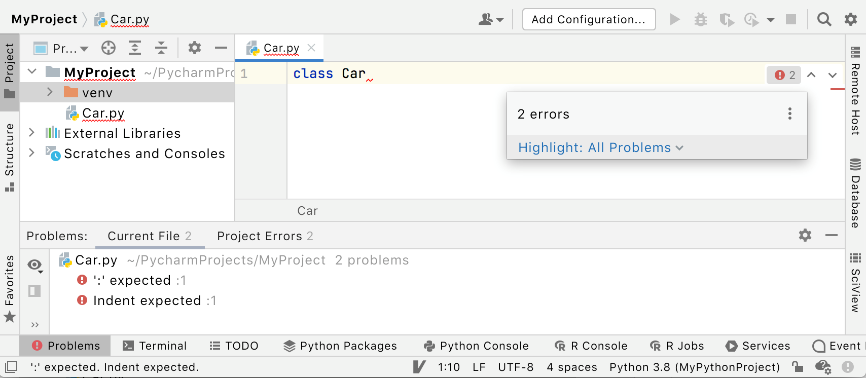
Edit Python code﻿
STEP 2:PyCharm informs you about the missing colon, then expected indentation:

Slide 18
TRY THE CODE
PyCharm includes various standards for writing code with proper indentations valid for Python.
This makes it interesting to improve the code standards and writing the complete code in PyCharm editor.
Improving Code Completion
Code completion in PyCharm is really unique. You can enhance it further using many other features. Note that the editor provides start and end of the code block.
Consider a file named Apt3010.py with the following code −

Slide 19
Code#1:Add 2 numbers.
x = 5
y = 10
print(x + y)

Slide 20
Date Output Code#3:Add 2 numbers+user input.
import datetime
x = datetime.datetime.now()
print(x)

Slide 21
User Input
Python allows for user input.
That means we are able to ask the user for input.
The method is a bit different in Python 3.6 than Python 2.7.
Python 3.6 uses the input() method.
Python 2.7 uses the raw_input() method.
The following example asks for the username, and when you entered the username, it gets printed on the screen:

Slide 22
User Input
Python 3.6
username = input("Enter username:")
print("Username is: " + username)
Python 2.7
username = raw_input("Enter username:")
print("Username is: " + username)

Slide 23
Code#2:Add 2 numbers+user input.
x = input("Type a number: ") y = input("Type another number: ") sum = int(x) + int(y) print("The sum is: ", sum)

Slide 24
TRY THE CODE
message = 'GIEWIVrGMTLIVrHIQS' #encrypted message
LETTERS = 'ABCDEFGHIJKLMNOPQRSTUVWXYZ'
for key in range(len(LETTERS)):
translated = ''
for symbol in message:
if symbol in LETTERS:
num = LETTERS.find(symbol)
num = num - key
if num < 0:
num = num + len(LETTERS)
translated = translated + LETTERS[num]
else:
translated = translated + symbol
print('Hacking key #%s: %s' % (key, translated))

Slide 25
Python Classes/Objects.
Python is an object oriented programming language.
Almost everything in Python is an object, with its properties and methods.
A Class is like an object constructor, or a "blueprint" for creating objects.

Slide 26
Python Classes/Objects.
Create a Class
To create a class, use the keyword class:
Example
Create a class named MyClass, with a property named x:
class MyClass:
x = 5

Slide 27
Python Classes/Objects.
Create Object
Now we can use the class named MyClass to create objects:
Example
Create an object named p1, and print the value of x:
p1 = MyClass()
print(p1.x)

Slide 28
The __init__() Function
The examples above are classes and objects in their simplest form, and are not really useful in real life applications.
To understand the meaning of classes we have to understand the built-in __init__() function.
All classes have a function called __init__(), which is always executed when the class is being initiated.
Use the __init__() function to assign values to object properties, or other operations that are necessary to do when the object is being created:

Slide 29
The __init__() Function
Example
Create a class named Person, use the __init__() function to assign values for name and age:
class Person:
def __init__(self, name, age):
self.name = name
self.age = age
p1 = Person("John", 36)
print(p1.name)
print(p1.age)

Slide 30
The __init__() Function
The __str__() Function
The __str__() function controls what should be returned when the class object is represented as a string.
If the __str__() function is not set, the string representation of the object is returned:
class Person:
def __init__(self, name, age):
self.name = name
self.age = age
p1 = Person("John", 36)
print(p1)

Slide 31
The __init__() Function
Example
The string representation of an object WITH the __str__() function:
class Person:
def __init__(self, name, age):
self.name = name
self.age = age
def __str__(self):
return f"{self.name}({self.age})"
p1 = Person("John", 36)
print(p1)

Slide 32
Object Methods.
Object Methods
Objects can also contain methods. Methods in objects are functions that belong to the object.
Let us create a method in the Person class:
class Person:
def __init__(self, name, age):
self.name = name
self.age = age
def myfunc(self):
print("Hello my name is " + self.name)
p1 = Person("John", 36)
p1.myfunc()

Slide 33
The self Parameter
The self parameter is a reference to the current instance of the class, and is used to access variables that belongs to the class.
It does not have to be named self , you can call it whatever you like, but it has to be the first parameter of any function in the class:
class Person:
def __init__(self, name, age):
self.name = name
self.age = age
def myfunc(self):
print("Hello my name is " + self.name)
p1 = Person("John", 36)
p1.myfunc()

Slide 34
DATABASES.
PyCharm supports interface support with various types of databases.
Once a user grants access to the created database, it provides schema diagram of the database with SQL writing tools which provide code completion.

Slide 35
Python Inheritance
Python Inheritance
Inheritance allows us to define a class that inherits all the methods and properties from another class.
Parent class is the class being inherited from, also called base class.
Child class is the class that inherits from another class, also called derived class.

Slide 36
Python Inheritance
Create a Parent Class
Any class can be a parent class, so the syntax is the same as creating any other class:
Example
Create a class named Person, with firstname and lastname properties, and a printname method:

Slide 37
Python Inheritance
class Person:
def __init__(self, fname, lname):
self.firstname = fname
self.lastname = lname
def printname(self):
print(self.firstname, self.lastname)
#Use the Person class to create an object, and then execute the printname method:
x = Person("John", "Doe")
x.printname()

Slide 38
Python Inheritance
Create a Child Class
To create a class that inherits the functionality from another class, send the parent class as a parameter when creating the child class:
Example
Create a class named Student, which will inherit the properties and methods from the Person class:
class Student(Person):
pass

Slide 39
Python Inheritance
Create a Child Class
To create a class that inherits the functionality from another class, send the parent class as a parameter when creating the child class:
Example
Create a class named Student, which will inherit the properties and methods from the Person class:
class Student(Person):
pass

Slide 40
Python Inheritance
Add the __init__() Function
So far we have created a child class that inherits the properties and methods from its parent.
We want to add the __init__() function to the child class (instead of the pass keyword).
Note: The __init__() function is called automatically every time the class is being used to create a new object.
class Student(Person):
def __init__(self, fname, lname):
Person.__init__(self, fname, lname)

Slide 41
Use the super() Function
Python also has a super() function that will make the child class inherit all the methods and properties from its parent:
By using the super() function, you do not have to use the name of the parent element, it will automatically inherit the methods and properties from its parent.
Example
class Student(Person): def __init__(self, fname, lname): super().__init__(fname, lname)

Slide 42
Add Properties
Example
Add a year parameter, and pass the correct year when creating objects:
class Student(Person):
def __init__(self, fname, lname, year):
super().__init__(fname, lname)
self.graduationyear = year
x = Student("Mike", "Olsen", 2019)

Slide 43
Add Properties.
In the example below, the year 2019 should be a variable, and passed into the Student class when creating student objects.
To do so, add another parameter in the __init__() function:
Example
Add a property called graduationyear to the Student class:
class Student(Person):
def __init__(self, fname, lname):
super().__init__(fname, lname)
self.graduationyear = 2019

Slide 44
Add Properties.
In the example below, the year 2019 should be a variable, and passed into the Student class when creating student objects.
To do so, add another parameter in the __init__() function:
class Student(Person): def __init__(self, fname, lname, year): super().__init__(fname, lname) self.graduationyear = year x = Student("Mike", "Olsen", 2019)

Slide 45
Add Methods
Example
Add a method called welcome to the Student class
class Student(Person):
def __init__(self, fname, lname, year):
super().__init__(fname, lname)
self.graduationyear = year
def welcome(self):
print("Welcome", self.firstname, self.lastname, "to the class of", self.graduationyear)

Slide 46
DATABASES.
Adding a Data Source
It is important to keep a note that PyCharm supports a wide variety of database connectivity.
Step 1
Open the database tool window View -> Tool Windows -> Database> and open the dialog called Data Sources and Dialog.

Slide 47
File Handling
ile handling is an important part of any web application.
Python has several functions for creating, reading, updating, and deleting files.
The key function for working with files in Python is the open() function.
The open() function takes two parameters; filename, and mode.
There are four different methods (modes) for opening a file:

Slide 48
File Handling
"r" - Read - Default value. Opens a file for reading, error if the file does not exist
"a" - Append - Opens a file for appending, creates the file if it does not exist
"w" - Write - Opens a file for writing, creates the file if it does not exist
"x" - Create - Creates the specified file, returns an error if the file exists

Slide 49
File Handling
Syntax
To open a file for reading it is enough to specify the name of the file:
f = open("demofile.txt")
The code above is the same as:
f = open("demofile.txt", "rt")

Slide 50
Open a File on the Server
Assume we have the following file, located in the same folder as Python:
demofile.txt
Hello! Welcome to demofile.txt
This file is for testing purposes.
Good Luck!
To open the file, use the built-in open() function.
The open() function returns a file object, which has a read() method for reading the content of the file:
f = open("demofile.txt", "r") print(f.read())

Slide 51
Open a File on the Server
Open a file on a different location:
f = open("D:\\myfiles\welcome.txt", "r") print(f.read())

Slide 52
Python File Write
Write to an Existing File
To write to an existing file, you must add a parameter to the open() function:
"a" - Append - will append to the end of the file
"w" - Write - will overwrite any existing content.
Example
Open the file "demofile2.txt" and append content to the file:
f = open("demofile2.txt", "a") f.write("Now the file has more content!") f.close() #open and read the file after the appending: f = open("demofile2.txt", "r") print(f.read())

Slide 53
Python File Write
Example
Open the file "demofile3.txt" and overwrite the content:
f = open("demofile3.txt", "w") f.write("Woops! I have deleted the content!") f.close() #open and read the file after the appending: f = open("demofile3.txt", "r") print(f.read())

Slide 54
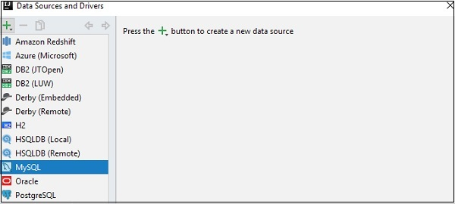
DATABASES.

Slide 55
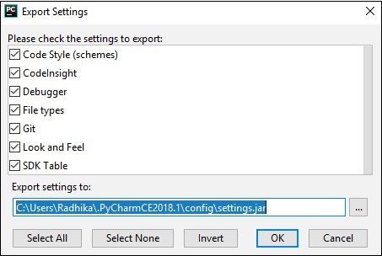
Pycharm - Exporting Data
PyCharm IDE includes various features for converting the existing code file into HTML format or CSV format.
The export settings of PyCharm editor are shown in the figure given below −

Slide 56
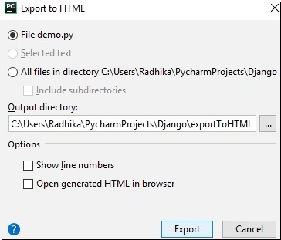
Export to HTML feature
This feature helps in exporting the specific file in HTML format.
This is done to improve the security purposes of the given module. The following screenshot gives a better understanding −

Slide 57
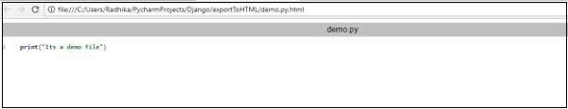
Export to HTML feature
Once the export operation is successful, the generated HTML file will display in browser output as shown below −

Slide 58
Export to HTML feature
Now, if you check the HTML code generated after the export operation, you can observe that line numbers are also included to achieve this operation.

Slide 59
Pycharm - Web Frameworks
PyCharm has a simple functionality to deploy code and files.
To deploy code with PyCharm, we need to add a web server with Menu Option: File->Settings -> Build, Execution-> Deployment.

Slide 60
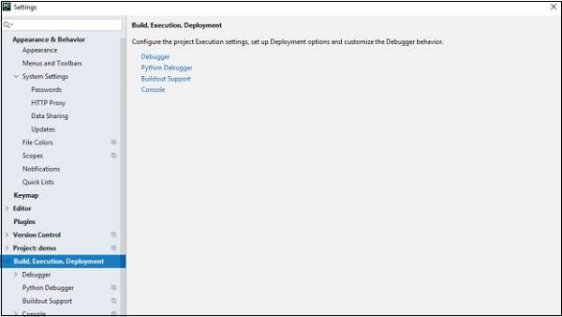
Pycharm - Web Frameworks

